Slide 1


EXPLORATORY PROJECT REPORT​
Anomaly Detection in IoT sensors using Machine Learning and Deep Learning.
Under the guidance of Professor
‘Dr. Kishor Sarawadekar’
Group Members
Debasish Chakraborty 20095131
Sakshi Gulati 20095097
Suryansh Singh 20095148

Slide 2


Slide 3
Overview​
Anomaly detection in the Internet of Things (IoT) infrastructure is a rising concern in the domain of IoT. With the increased use of IoT infrastructure in every domain, threats and attacks in these infrastructures are also growing commensurately.
Solution – We present our Machine Learning model to detect and predict attack/anomaly in IOT sensors and also we perform a comparative study to find the best approach among various Machine Learning/ Deep Learning techniques and models by comparing them on the basis of Accuracy, Prediction, and ROC.

Slide 4
Introduction
Sensors are everywhere. They’re in our homes and workplaces, our shopping centers and hospitals. They’re embedded in smart phones and an integral part of the Internet of Things (IoT). Broadly speaking, sensors are devices that detect and respond to changes in an environment. Inputs can come from a variety of sources such as light, temperature, motion and pressure.
With this technology, you can remotely control the temperature and humidity levels of the air conditioner at your home and detect anomalies inside the house. IoT innovation made it possible to connect everyday things to the internet. There are various types of sensors mainly Temperature Sensors, Light Sensors, Humidity Sensors, Pressure Sensors, Proximity Sensors, Level Sensors, Accelerometers, Gas Sensors, Optical Sensors and Infrared Sensors.
But with the rapid advancement of IoT technology, there is also a huge possibility of various threats and anomalies in IoT Devices. Therefore enhancing the security of IoT networks is trending as one of the most crucial issues the information technology community faces. With large scales of IoT devices being developed and deployed, the ability for these devices to communicate securely without compromising performance is challenging.

Slide 5
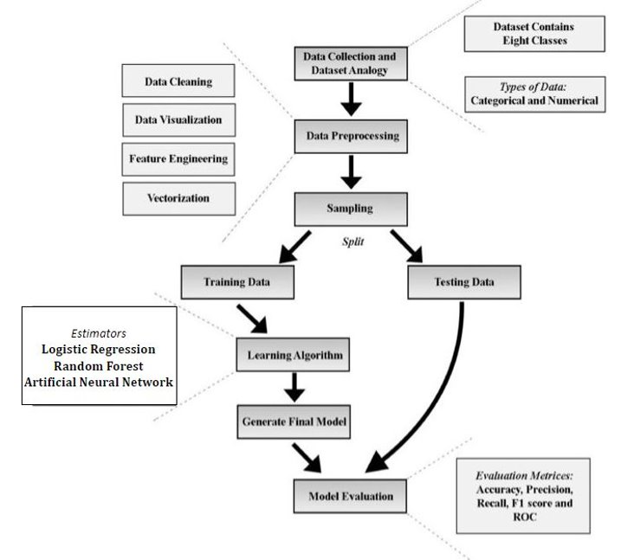
How Is It Done

Slide 6
Dataset Collection
The open source dataset was collected from kaggle. https://www.kaggle.com/francoisxa/ds2ostraffictraces
In the dataset, there are 357,952 samples and 13 features. The dataset has 347,935 Normal data and 10,017 anomalous data and contains eight classes which were classified. Features “Accessed Node Type” and “Value” have 148 and 2050 missing data, respectively.
Denial of Service(DoS) | Data Type Probing (D.P)
Malicious Control (M.C) | Malicious Operation (M.O)
Scan(SC) | Spying (SP)
Wrong Setup (W.S) | Normal(NL)

Slide 7
Models Used
i) Logistic Regression:
Logistic regression is one of the most popular Machine Learning algorithms, which comes under the Supervised Learning technique. It is used for predicting the categorical dependent variable using a given set of independent variables.
Logistic regression predicts the output of a categorical dependent variable. Therefore the outcome must be a categorical or discrete value. It can be either Yes or No, 0 or 1, True or False, etc. but instead of giving the exact value as 0 and 1, it gives the probabilistic values which lie between 0 and 1.
Logistic Regression is much similar to Linear Regression except that how they are used. Linear Regression is used for solving Regression problems, whereas Logistic regression is used for solving the classification problems.
In Logistic regression, instead of fitting a regression line, we fit an "S" shaped logistic function, which predicts two maximum values (0 or 1).

Slide 8
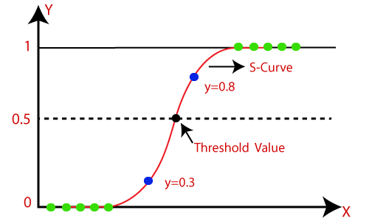
Logistic Regression is a significant machine learning algorithm because it has the ability to provide probabilities and classify new data using continuous and discrete datasets.
The below image is showing the logistic function:

Slide 9
ii) Random Forest :
Random forest is a Supervised Machine Learning Algorithm that is used widely in Classification and Regression problems. It builds decision trees on different samples and takes their majority vote for classification and average in case of regression and can handle the data set containing continuous variables as in the case of regression and categorical variables as in the case of classification.
In Random forest n number of random records are taken from the data set having k number of records.
Individual decision trees are constructed for each sample.
Each decision tree will generate an output.
Final output is considered based on Majority Voting or Averaging for Classification and regression respectively.

Slide 10
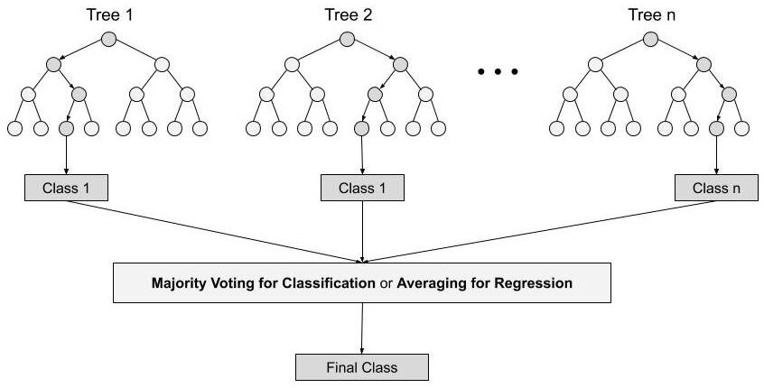

Slide 11
iii) Artificial Neural Network :
Input Layers
The input layer is the first layer of an ANN that receives the input information in the form of various texts, numbers, audio files, image pixels, etc.
Hidden Layers
In the middle of the ANN model are the hidden layers. There can be a single hidden layer, as in the case of a perceptron or multiple hidden layers. These hidden layers perform various types of mathematical computation on the input data and recognize the patterns that are part of.
Output Layer
In the output layer, we obtain the result that we obtain through rigorous computations performed by the middle layer.
The output of ANNs is mostly dependent on weights, biases, learning rate, batch size etc.
Each node in the network has some weights assigned to it. A transfer function is used for calculating the weighted sum of the inputs and the bias.

Slide 12
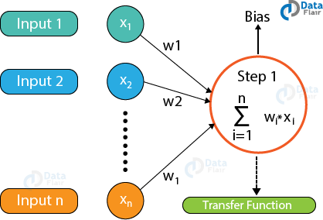
After the transfer function has calculated the sum, the activation function obtains the result. Based on the output received, the activation functions fire the appropriate result from the node.Some of the popular activation functions used in Artificial Neural Networks are Sigmoid, RELU, Softmax, tanh etc.

Slide 13
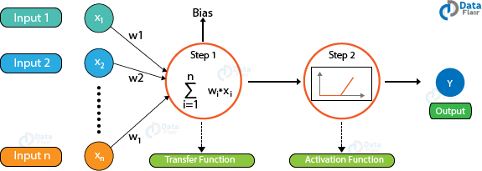
Based on the value that the node has fired, we obtain the final output. Then, using the error functions, we calculate the discrepancies between the predicted output and resulting output and adjust the weights of the neural network through a process known as backpropagation.

Slide 14
Code
Data Preprocessing
Required Libraries :
import pandas as pd
import numpy as np
from google.colab import drive
drive.mount('/content/drive')
from sklearn.preprocessing import LabelEncoder
Loading Dataset :
df_data_1 = pd.read_csv("/content/drive/MyDrive/Explo_Dataset/main_data.csv")

Slide 15
Missing Values :
df_data_1.head()
df_data_1['accessedNodeType'] = df_data_1['accessedNodeType'].fillna(value='/Malicious')
Unexpected Values :
df_data_1.loc[df_data_1.value=='twenty',"value"] = '20.0'
df_data_1.loc[df_data_1.value=='false',"value"] = '0'
df_data_1.loc[df_data_1.value=='true',"value"] = '1'
df_data_1.loc[df_data_1.value=='none',"value"] = '0'
df_data_1.loc[df_data_1.value=='0',"value"] = '0.0'
df_data_1['value'] = df_data_1['value'].fillna(value='60.0')
df_data_1 = df_data_1.drop(df_data_1.index[df_data_1.value.str.contains("org.*")])
df_data_1.value = df_data_1.value.astype(float)

Slide 16
Making Features using Label Encoding :
df_1 = df_data_1.drop('timestamp',axis=1)
labelencoder0 = LabelEncoder()
labelencoder1 = LabelEncoder()
labelencoder4 = LabelEncoder()
labelencoder7 = LabelEncoder()
labelencodery = LabelEncoder()
X_0 = df_1.iloc[:,0].values
X_1 = df_1.iloc[:,1].values
X_4 = df_1.iloc[:,4].values
X_7 = df_1.iloc[:,7].values
y = df_1.iloc[:,11].values
X_0 = labelencoder0.fit_transform(X_0)
X_0 = X_0.reshape(len(X_0),1)
X_1 = labelencoder1.fit_transform(X_1)
X_1 = X_1.reshape(len(X_1),1)
X_4 = labelencoder4.fit_transform(X_4)
X_4 = X_4.reshape(len(X_4),1)
X_7 = labelencoder7.fit_transform(X_7)
X_7 = X_7.reshape(len(X_7),1)
y = labelencodery.fit_transform(y)
y_resized = y.reshape(len(y),1)

Slide 17
le_2 = LabelEncoder()
le_3 = LabelEncoder()
le_5 = LabelEncoder()
le_6 = LabelEncoder()
le_8 = LabelEncoder()
le_9 = LabelEncoder()
X_2 = df_1.iloc[:,2].values
X_3 = df_1.iloc[:,3].values
X_5 = df_1.iloc[:,5].values
X_6 = df_1.iloc[:,6].values
X_8 = df_1.iloc[:,8].values
X_9 = df_1.iloc[:,9].values
X_10 = df_1.iloc[:,10].values
X_2 = le_2.fit_transform(X_2)
X_2 = X_2.reshape(len(X_2),1)
X_3 = le_3.fit_transform(X_3)
X_3 = X_3.reshape(len(X_3),1)
X_5 = le_5.fit_transform(X_5)
X_5 = X_5.reshape(len(X_5),1)
X_6 = le_6.fit_transform(X_6)
X_6 = X_6.reshape(len(X_6),1)
X_8 = le_8.fit_transform(X_8)
X_8 = X_8.reshape(len(X_8),1)
X_9 = le_9.fit_transform(X_9)
X_9 = X_9.reshape(len(X_9),1)
X_10 = X_10.reshape(len(X_10),1)
X = np.concatenate((X_0,X_1,X_2,X_3,X_4,X_5,X_6,X_7,X_8,X_9,X_10),axis=1)
y_resized = y.reshape(len(y),1)
df_explo = np.concatenate((y_resized,X),axis=1)
df_explo = pd.DataFrame(df_explo)

Slide 18
K - FOLDS CROSS VALIDATION
Cross-validation is a resampling procedure used to evaluate machine learning models on a limited data sample. It used to estimate the skill of a machine learning model on unseen data.
The procedure has a single parameter called k that refers to the number of groups that a given data sample is to be split into. As such, the procedure is often called k-fold cross-validation. When a specific value for k is chosen, it may be used in place of k in the reference to the model, such as k=10 becoming 10-fold cross-validation. It generally results in a less biased or less optimistic estimate of the model skill than other methods, such as a simple train/test split.
Configuration of K The k value must be chosen carefully for your data sample. A poorly chosen value for k may result in a mis-representative idea of the skill of the model, such as a score with a high variance (that may change a lot based on the data used to fit the model), or a high bias, (such as an overestimate of the skill of the model).

Slide 19
Why do we need K - Folds Cross Validation :
Once we are done with training our model, we just can’t assume that it is going to work well on data that it has not seen before. In other words, we can't be sure that the model will have the desired accuracy and variance in production environment. For this, we need to validate our model.
To evaluate the performance of any machine learning model we need to test it on some unseen data. Based on the models performance on unseen data we can say weather our model is Under-fitting/Over-fitting/Well generalized. Cross validation (CV) is one of the technique used to test the effectiveness of a machine learning models, it is also a re-sampling procedure used to evaluate a model if we have a limited data.
K-Folds technique is a popular and easy to understand, it generally results in a less biased model compare to other methods. Because it ensures that every observation from the original dataset has the chance of appearing in training and test set. This is one among the best approach if we have a limited input data.

Slide 20
Model Training and Testing
Required Libraries :
import pandas as pd
import numpy as np
from google.colab import drive
drive.mount('/content/drive')
from sklearn.preprocessing import StandardScaler
from sklearn.pipeline import Pipeline
from sklearn.linear_model import LogisticRegression
from sklearn.metrics import accuracy_score
import matplotlib.pyplot as plt
from sklearn.model_selection import learning_curve
Splitting Dataset into 80:20 ratio (Train dataset contains 80% features and Test Dataset contains 20% features) :
from sklearn.model_selection import train_test_split
X_train, X_test, y_train, y_test = train_test_split(X,y, test_size=0.2, random_state = 1)

Slide 21
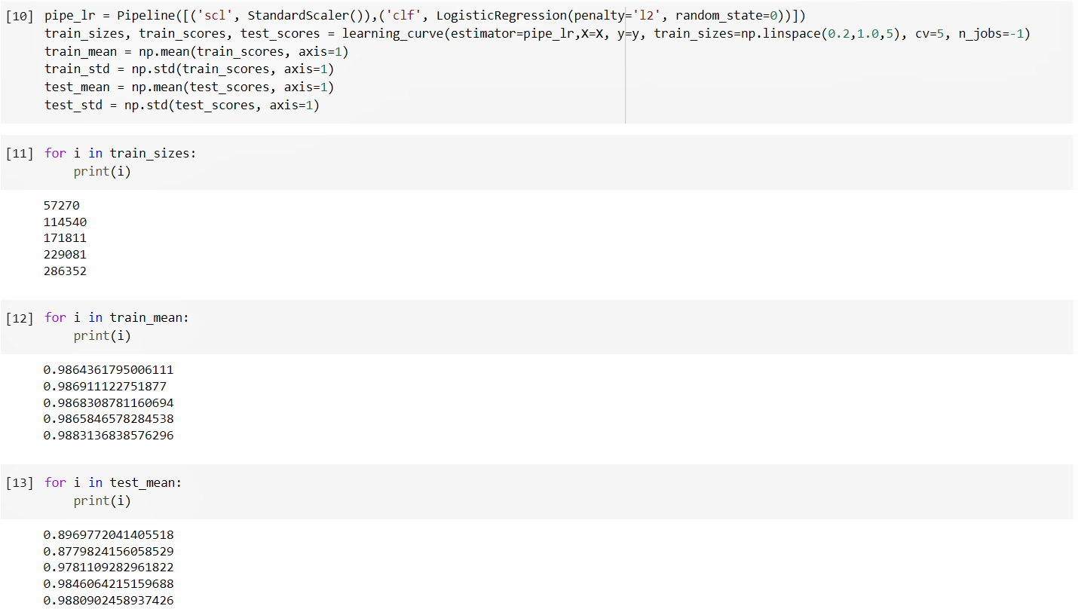
5-Fold Cross validation Estimation for Logistic Regression :

Slide 22
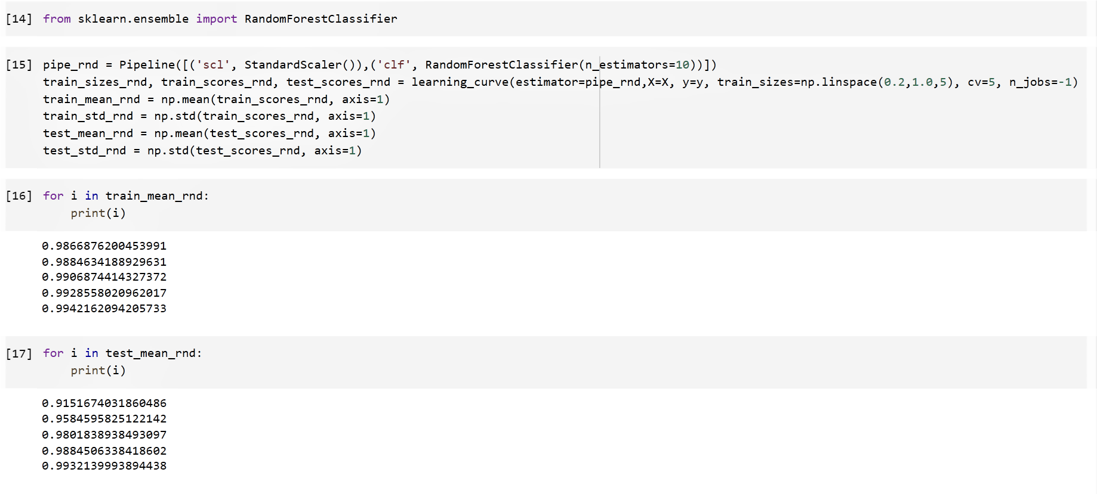
5-Fold Cross validation Estimation for Random Forest :

Slide 23
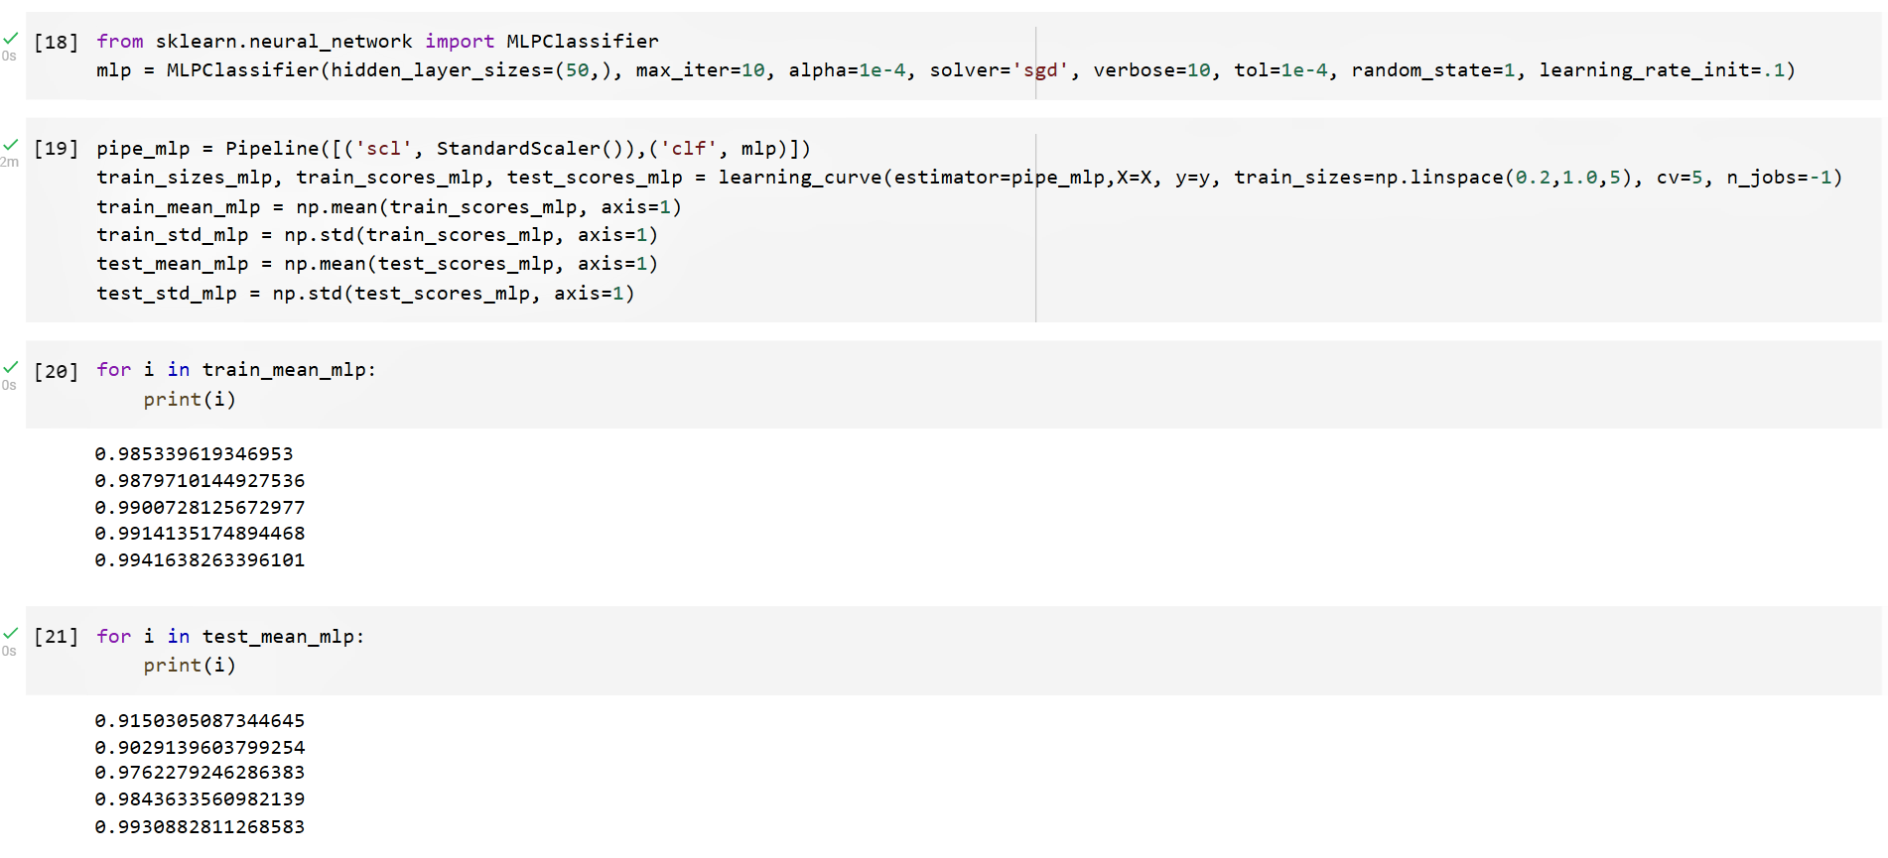
5-Fold Cross validation Estimation for ANN :

Slide 24
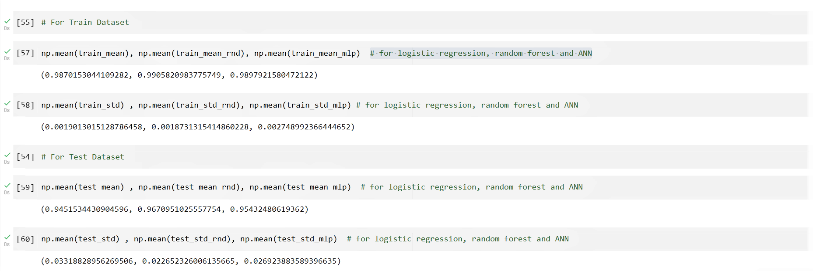
Mean values of Training and Testing accuracies and Standard Deviation of Training and Testing accuracies :

Slide 25
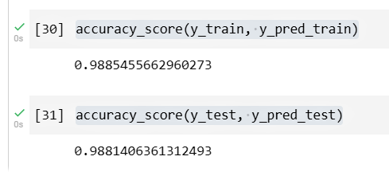
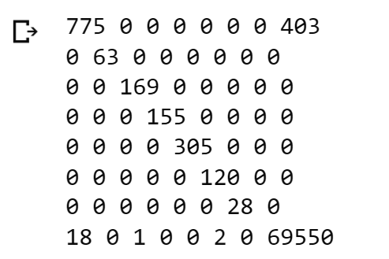
Evaluation Metrics Calculations for Models
i) Logistic Regression :
pipe_lr = pipe_lr.fit(X_train, y_train)
y_pred_train = pipe_lr.predict(X_train)
y_pred_test = pipe_lr.predict(X_test)
accuracy_score(y_train, y_pred_train)
accuracy_score(y_test, y_pred_test)
from sklearn.metrics import confusion_matrix
import itertools
cnf_matrix = confusion_matrix(y_test, y_pred_test)
for i in cnf_matrix:
for j in i:
print(j, end=' ')
print()

Slide 26
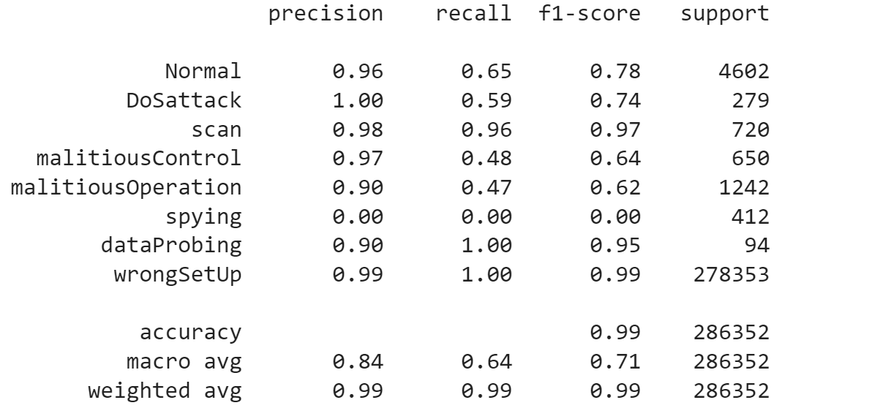
from sklearn.metrics import classification_report
target_names = ['Normal', 'DoSattack', 'scan', 'malitiousControl', 'malitiousOperation', 'spying', 'dataProbing', 'wrongSetUp']
print(classification_report(y_train, y_pred_train, target_names=target_names))

Slide 27

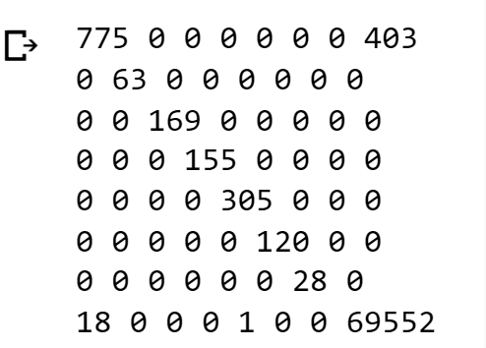
ii) Random Forest :
pipe_rnd = pipe_rnd.fit(X_train, y_train)
y_pred_train = pipe_rnd.predict(X_train)
y_pred_test = pipe_rnd.predict(X_test)
y_pred_train = pipe_rnd.predict(X_train)
y_pred_test = pipe_rnd.predict(X_test)
accuracy_score(y_train, y_pred_train), accuracy_score(y_test, y_pred_test)
cnf_matrix = confusion_matrix(y_test, y_pred_test)
for i in cnf_matrix:
for j in i:
print(j, end=' ')
print()

Slide 28
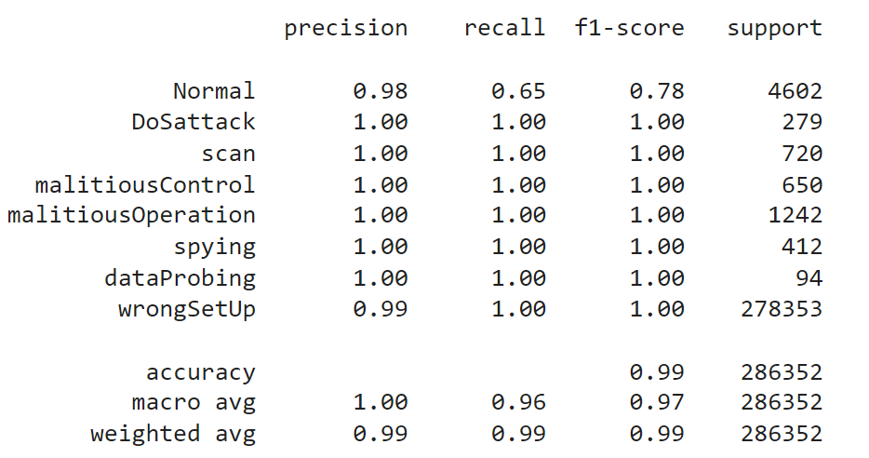
print(classification_report(y_train, y_pred_train, target_names=target_names))

Slide 29
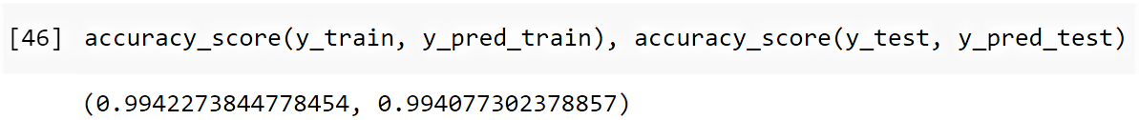
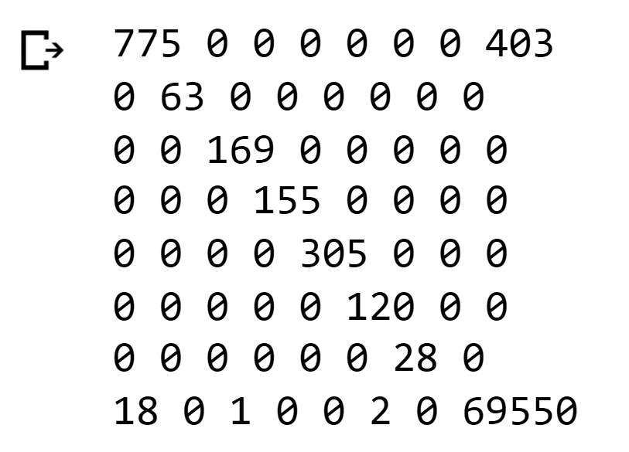
iii) Artificial Neural Network :
pipe_mlp = pipe_mlp.fit(X_train, y_train)
y_pred_train = pipe_mlp.predict(X_train)
y_pred_test = pipe_mlp.predict(X_test)
accuracy_score(y_train, y_pred_train), accuracy_score(y_test, y_pred_test)
from sklearn.metrics import confusion_matrix
import itertools
cnf_matrix = confusion_matrix(y_test, y_pred_test)
for i in cnf_matrix:
for j in i:
print(j, end=' ')
print()

Slide 30
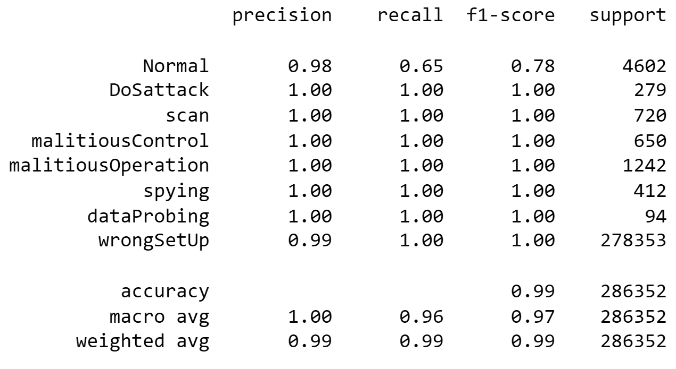
print(classification_report(y_train, y_pred_train, target_names=target_names))

Slide 31


Evaluation Criteria For Best Model :
Confusion matrix
Receiver operating characteristic curve

Slide 32
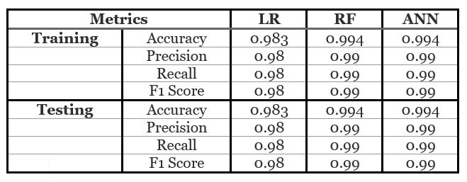
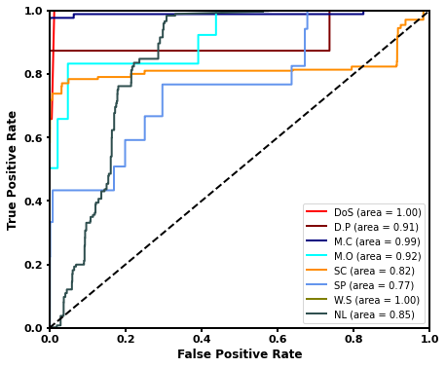
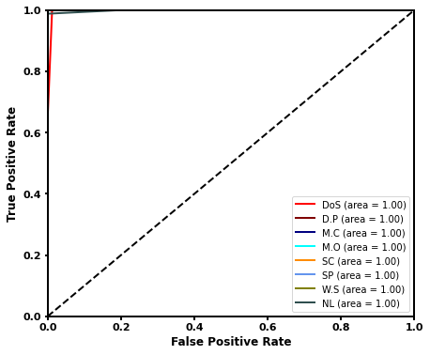

RESULT ANALYSIS
LR | RF | ANN

Slide 33
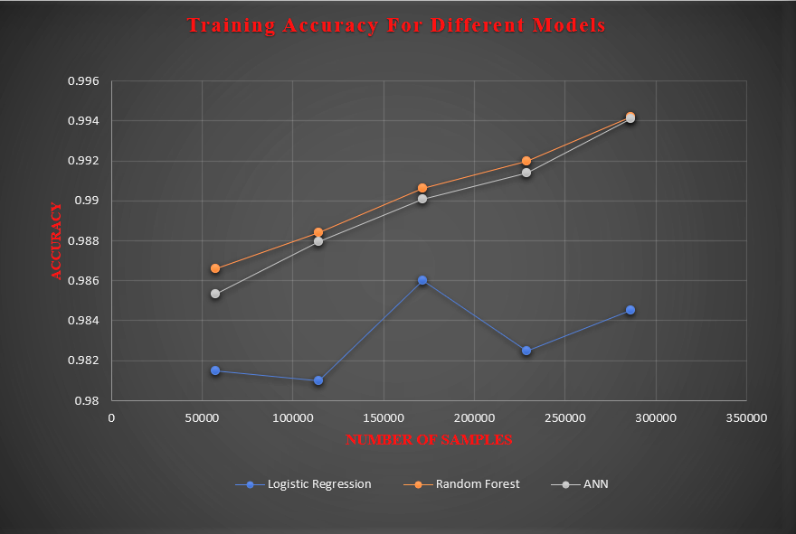
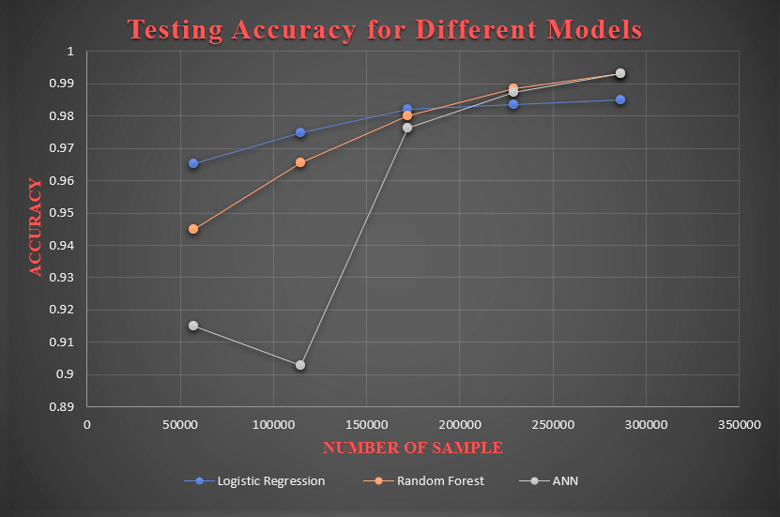
From the cross-validation, it can be inferred that RF and ANN have performed best both in training and testing accuracy while LR performed weaker than other techniques in training.
Also from the area under the curves of ROC, it can be described that RF, and ANN have higher accuracy because all of the area under the curves for every class is approximately equivalent to value one.
Now considering the confusion matrices of each technique, the most optimized technique can be found.
From the confusion matrices shown it can be concluded that RF is the best technique for this work.

Slide 34
Conclusion
Through this project we learnt about Internet of Things(IoT), IoT Sensors, threats and attacks on IoT Devices, various aspects of Data analysis, Data Cleaning and Preprocessing and about various Machine Learning models such as Logistic regression, Random Forest and Artificial Neural Networks. These are the trending technologies. And we also got to know about various aspects of IoT and about its tremendous growth in the field of Technology. Writing a long and challenging code helped us improve our coding skills and through all this, we learned fundamentals of an important technology that will be shaping the future society of human beings, i.e. Smart (/intelligent) IoT devices. We would like to thank our professor for helping us throughout this project , guiding us every moment.

Slide 35
References
Dataset - https://www.kaggle.com/francoisxa/ds2ostraffictraces
https://ieeexplore.ieee.org/document/9004362
https://journalofbigdata.springeropen.com/articles/10.1186/s40537-019-0268-2

Slide 36


